Slide 1
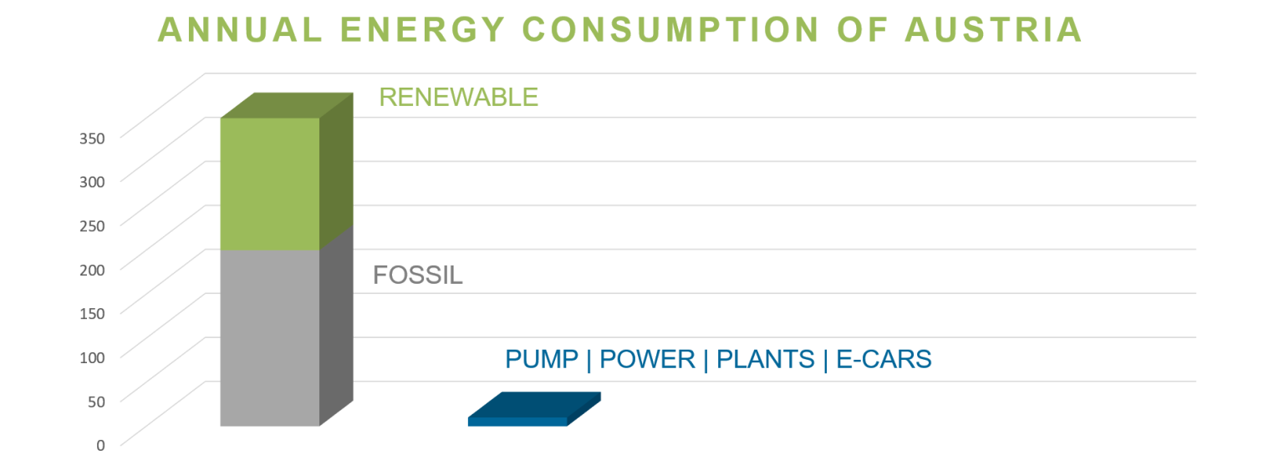
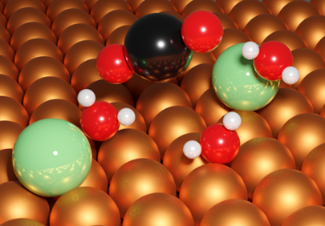
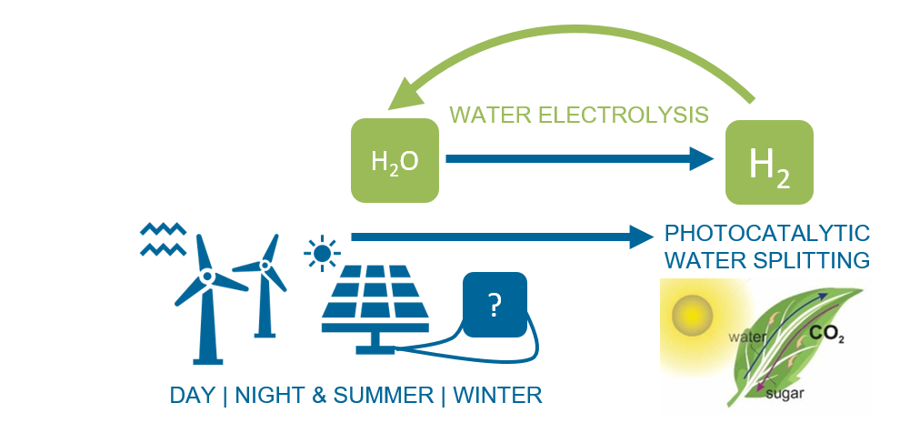
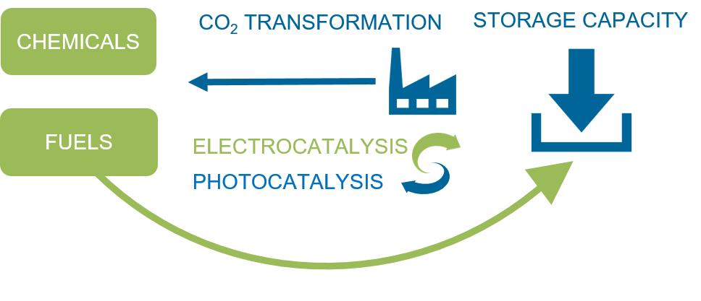
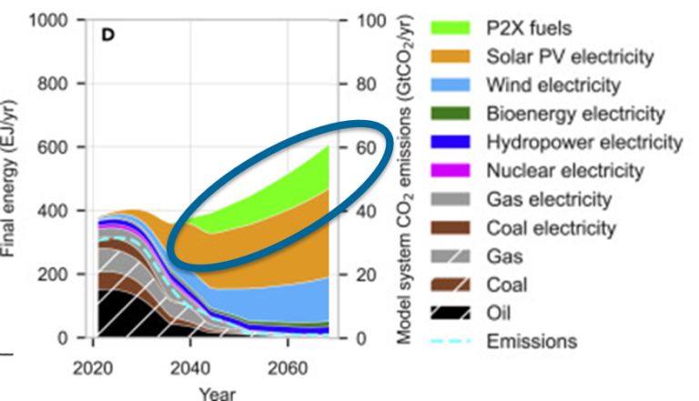
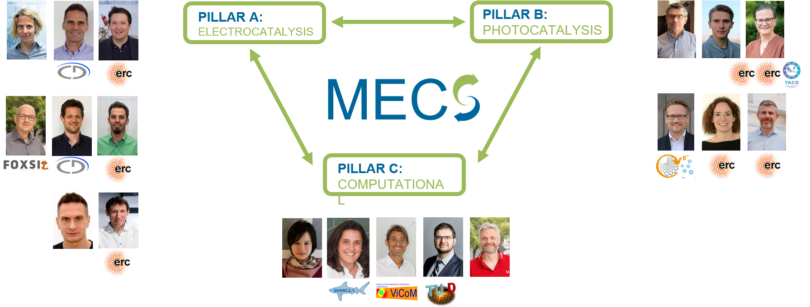
Cluster of Excellence
MATERIALS FOR ENERGY CONVERSION AND STORAGE
Director/Contact: Günther Rupprechter https://coe-mecs.at/WP/
About the CoE
THE ENERGY CRISIS: HIGH NOON!
Energy demand is growing, paralleled by worldwide global warming and climate change. Paradigm shift: Replacing fossil fuels by renewable resources.
Research Vision
THE ENERGY MATERIALS AGE
TAILORED COMPETITIVE SOLUTIONS FOR THE FUTURE REQUIRE:
TWh
Atomic-level understanding of the involved processes
Major breakthroughs in energy materials design (abundant, non-toxic, environmentally friendly, stable)
Fundamental research enables sustainable technologies
Challenge:
We have to store huge amounts of renewable energy, which can only be done in chemical bonds. Thus, we need reversible carriers for renewable energy.
Electro- and photocatalysis for the generation of green H₂, chemicals, and fuels.
Build a transformative centre that is a beacon of scientific excellence
Energy storage is a worldwide challenge, with MECS being a unique important asset
FWF + Institutions fund ca. 35 Mio €
Contributors:
19 outstanding researchers from 4 Institutions, with complementary expertise in physics, chemistry, materials science
A nucleus for synergies in Austria and internationally creating a sustainable network
Very diverse academic age & brain gain!
So far used: Rare expensive metals, low efficiency, not stable, or even toxic despite decades of academic and industrial research: Insufficient fundamental, atomistic, and mechanistic understanding

